Slide 1
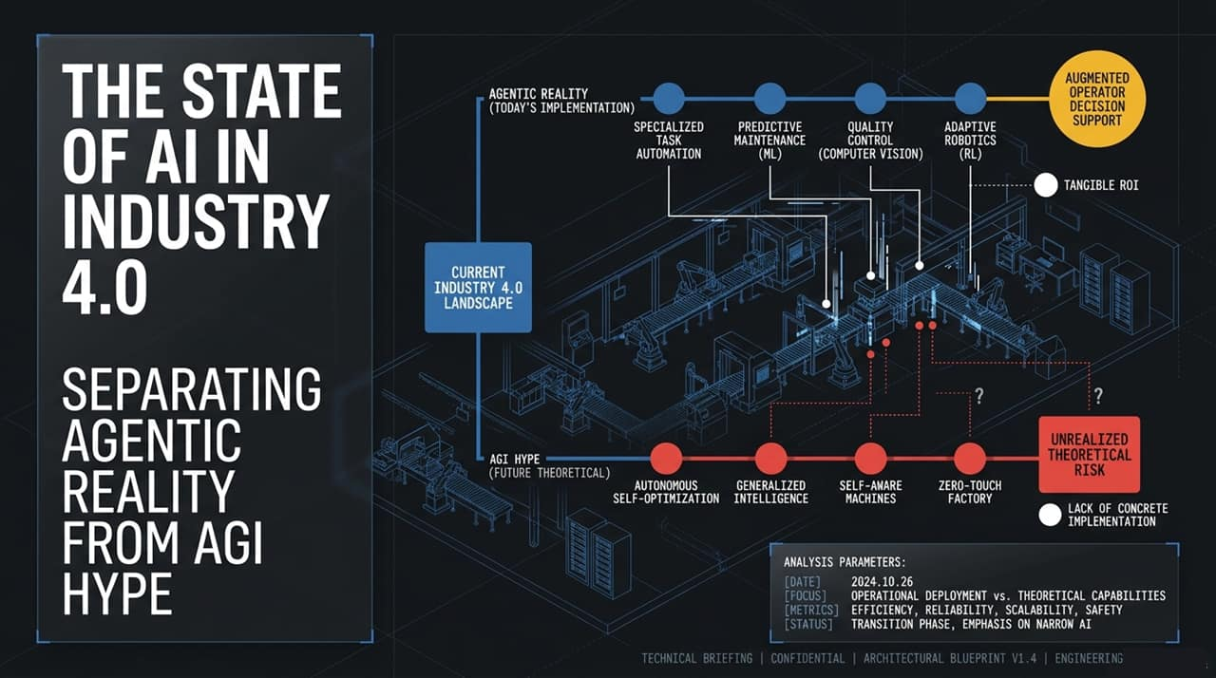
Notes:
Welcome, everyone. Today we are addressing the state of AI across Industry 4.0 and 5.0. Unless you’ve been living under a rock recently, you’ve seen the global conversation completely blow up around AI safety, existential risk, and regulation. We’ve received hundreds of questions asking where this technology is actually going, whether we're facing a crisis, and how this impacts industrial automation.
In this briefing, we are going to cut through the noise and cover three core areas:
Where we are right now: Distinguishing operational 'Agentic Reality' from the theoretical 'AGI Hype'.
Where the market is going: What vendors, OEMs, and integrators must build and adapt to survive the coming structural shift.
The truth behind AI safety and regulation: Examining who is lobbying for what, and why true safety in manufacturing requires clear liability, not regulatory moats.
Today’s implementation is built on specialized automation, predictive ML, computer vision, and adaptive robotics. It delivers tangible ROI and relies heavily on augmented operator decision support. Let's examine why confusing this reality with AGI is a major mistake.
https://www.youtube.com/watch?v=Own2-RUFkRg

Slide 2
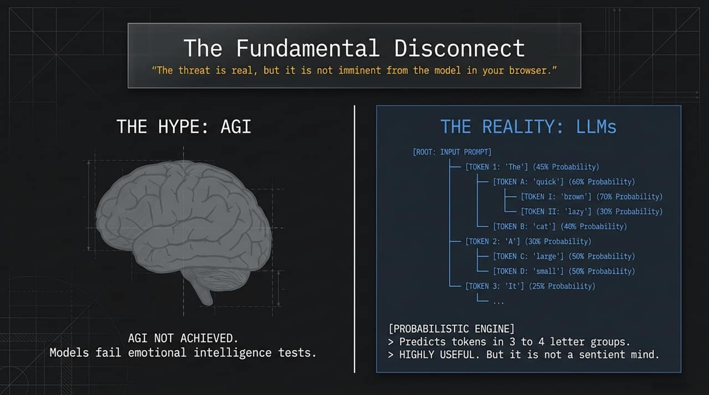
Notes:
Take a look at this blueprint of the human brain. When people hear the term 'Artificial Intelligence,' their mind naturally jumps to human cognition—sentience, reasoning, self-awareness, and emotional intelligence.
Executive leaders and tech CEOs often fuel this perception by dropping headlines about how close we are to Artificial General Intelligence (AGI). But conflating modern large language models with a human brain is the root cause of today's market confusion. Human intelligence possesses nuanced reasoning, context awareness, and emotional intelligence. To accurately evaluate AI's place on the factory floor, we must strip away this biological metaphor and examine what these models are actually doing under the hood.

Slide 3
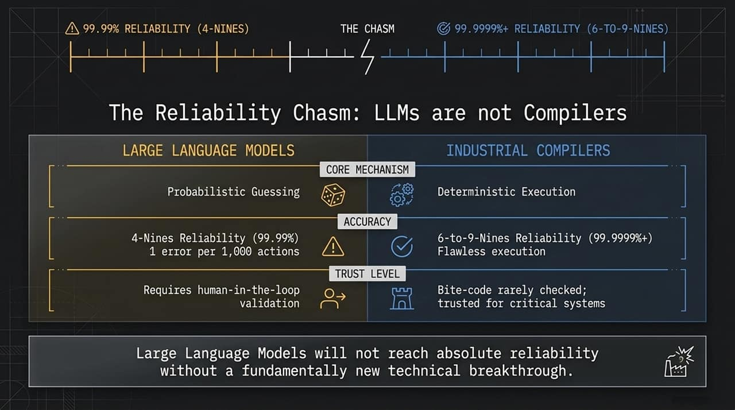
Notes:
Here is the architectural reality of current LLMs: they are probabilistic engines.
Look at the decision tree on the slide. When you feed an input prompt into a model like GPT or Claude, it isn't 'thinking' or 'understanding' your manufacturing line. It is calculating the statistical probability of the next token—predicting text in groups of 3 to 4 letter tokens.
If the prompt starts, the engine evaluates token probabilities: 'The' at 45%, 'A' at 30%, followed by 'quick' or 'brown' or 'cat' based on pattern recognition across massive datasets.
This probabilistic capability is extraordinarily useful—it's a massive productivity tool. But let’s be crystal clear: It is not a sentient mind, and it is not AGI. We have not achieved AGI because these models fail fundamental tests of emotional intelligence and true context-aware reasoning. Understanding that LLMs guess tokens rather than execute deterministic logic is critical to avoiding catastrophic implementation failures.

Slide 4
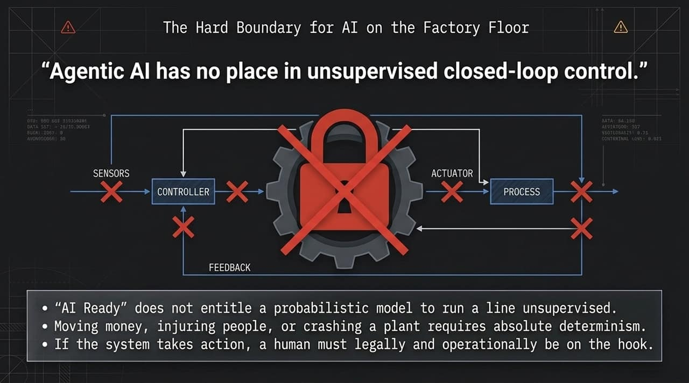
Notes:
This brings us to the core technical message: The threat of AI is real, but it is not imminent from the model sitting in your browser.
There is a massive, multi-order-of-magnitude Reliability Chasm between Large Language Models and Industrial Compilers.
LLMs operate on probabilistic guessing. Even the frontier models peak at around '4-Nines' of accuracy (99.99%). That sounds high until you calculate what it means: one error for every 1,000 actions. In software development or data analysis, human-in-the-loop verification makes 4-nines workable.
Industrial Compilers operate on deterministic execution. Software compilers that turn source code into byte code achieve between 6 to 9-Nines of reliability (99.9999%+ to near perfection). We don't inspect byte code after compilation because the compiler is mathematically proven and deterministic.
Some tech advocates argue we won't need to check agent-written code because 'we don't check compiler outputs.' That comparison is fundamentally flawed. LLMs will never reach 6-to-9 nines of reliability on probabilistic token prediction alone without an entirely new architectural breakthrough.

Slide 5
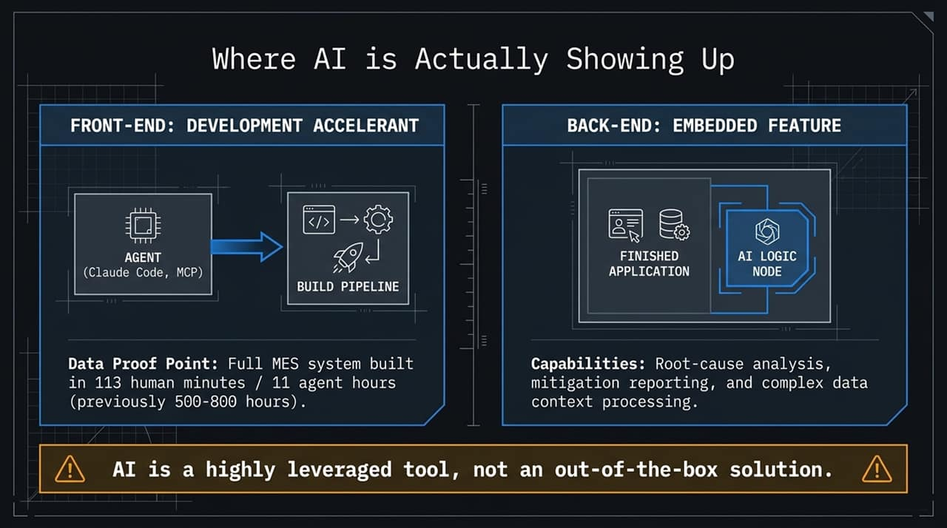
Notes:
Because of that reliability gap, we must draw a hard boundary: Agentic AI has no place in unsupervised closed-loop control.
Look at the control loop diagram on the screen: Sensors $→$Controller $→$Actuator $→$Process $→$Feedback. Proposing that a probabilistic, 4-nines model should directly manage this closed loop unsupervised is operationally reckless.
Let's lay down three non-negotiable rules for industrial operations:
'AI Ready' label does not equal permission: Just because a vendor markets an endpoint as 'AI Ready' does not give a probabilistic model authority to run a production line unsupervised.
Absolute determinism is mandatory: If an action can move money, injure workers, damage equipment, or crash a plant, it requires 100% deterministic logic.
Legal & operational accountability: If a system takes an autonomous action, a human being must legally and operationally be on the hook for the outcome.
Traditional SCADA and deterministic controllers remain essential. AI must stay outside the closed loop as decision support, while deterministic systems handle control.

Slide 6
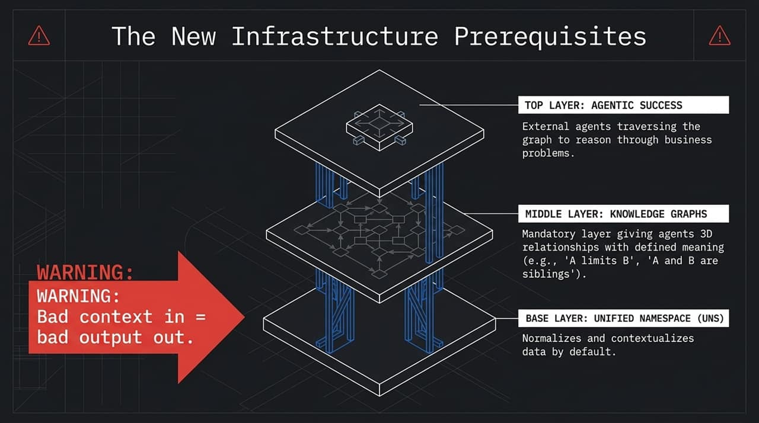
Notes:
So where is AI delivering massive value right now? It is showing up at two specific bookends: as a Front-End Development Accelerant and as a Back-End Embedded Feature.
Bookend 1: Development Accelerant
AI agents (using tools like Claude Code and Model Context Protocol) are dramatically altering development timelines. As a real-world data proof point: a complete Manufacturing Execution System (MES) was recently built in 113 human minutes and 11 agent hours. Historically, that exact same build took 500 to 800 engineering hours. That is a staggering 100x to 600x increase in developer leverage.
Bookend 2: Embedded Feature
On the back end, AI logic nodes operate within applications to process complex data context, conduct root-cause analysis, and auto-generate mitigation reporting.
The Key Takeaway: AI is a highly leveraged tool to build solutions and reason over data—it is not a turn-key, out-of-the-box solution by itself.

Slide 7
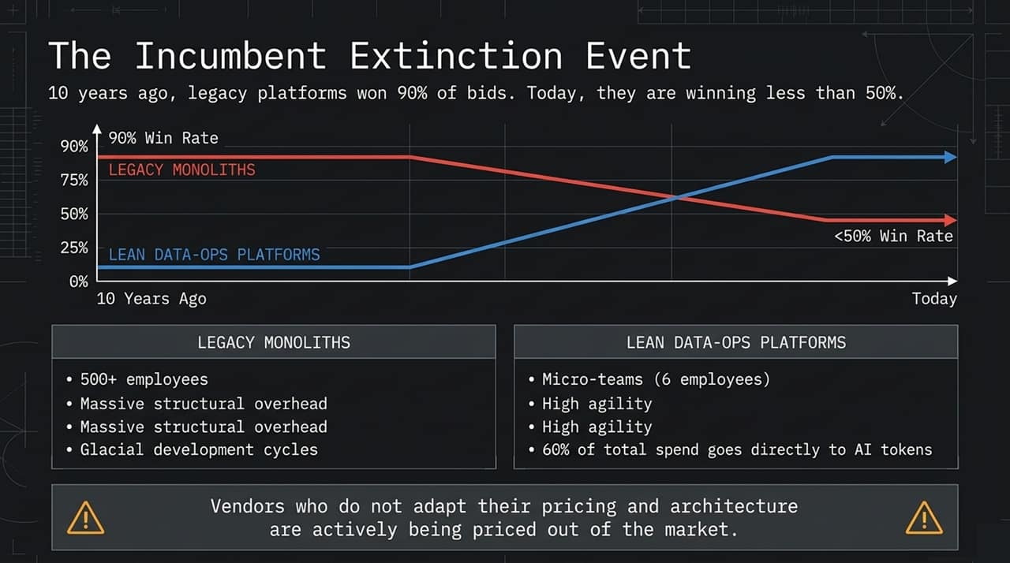
Notes:
If you want to successfully leverage Agentic AI in an enterprise, you cannot just plug an agent into legacy databases. You need a modern 3-layer infrastructure.
1. Base Layer: Unified Namespace (UNS)
You must have a UNS architecture that normalizes and contextualizes data by default across the enterprise. The golden rule of AI is 'Bad context in = bad output out'. AI does not fix bad context; it amplifies it.
2. Middle Layer: Knowledge Graphs This is now a mandatory layer, not a nice-to-have. Knowledge graphs provide 3D relational context with explicit meaning. An agent doesn't just need to know that 'Asset A' and 'Asset B' are connected; it needs to know how—e.g., 'A limits B,' 'A feeds B,' or 'A and B are sibling tanks'.
3. Top Layer: Agentic Success
With a solid UNS and Knowledge Graph, external AI agents can traverse the graph, understand operational relationships, and reason through business problems effectively.

Slide 8
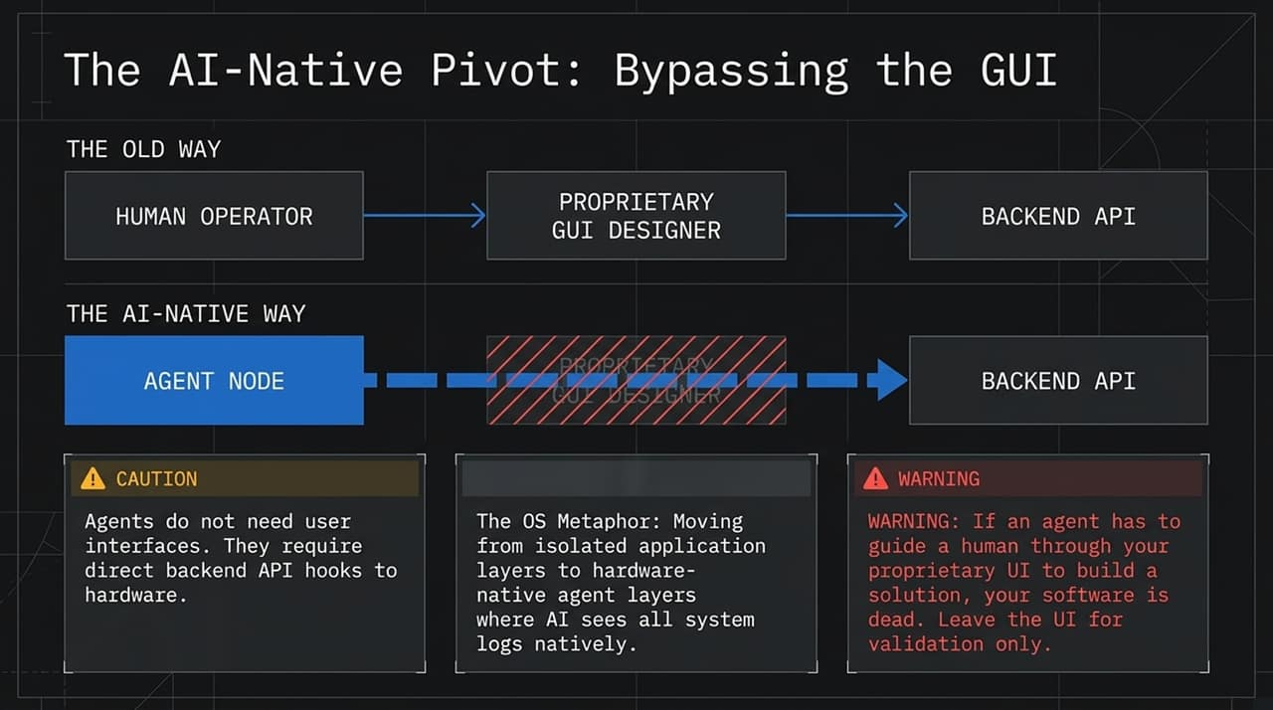
Notes:
We are witnessing a structural market shift that is actively pricing out legacy vendors.
Look at the Win-Rate Chart: A decade ago, legacy industrial software monoliths won 90% of market bids. Today, their win rates have plummeted below 50%. This isn't a minor dip; it’s an indicator of market disruption.
Why is this happening?
Legacy Monoliths carry massive headcount (500+ employees), heavy corporate overhead, and slow development cycles.
Lean Data-Ops Platforms operate with micro-teams (e.g., 6 employees). Up to 60% of their total spend goes directly to AI tokens rather than organizational bloat. They build world-class, agile platforms at a fraction of the cost.
End-users are realizing they no longer need to pay massive license fees for monolithic L3/L4 platforms when lean data-ops architectures allow them to build bespoke solutions in hours. Vendors who do not adapt their architecture and pricing models are getting priced out of the market.

Slide 9
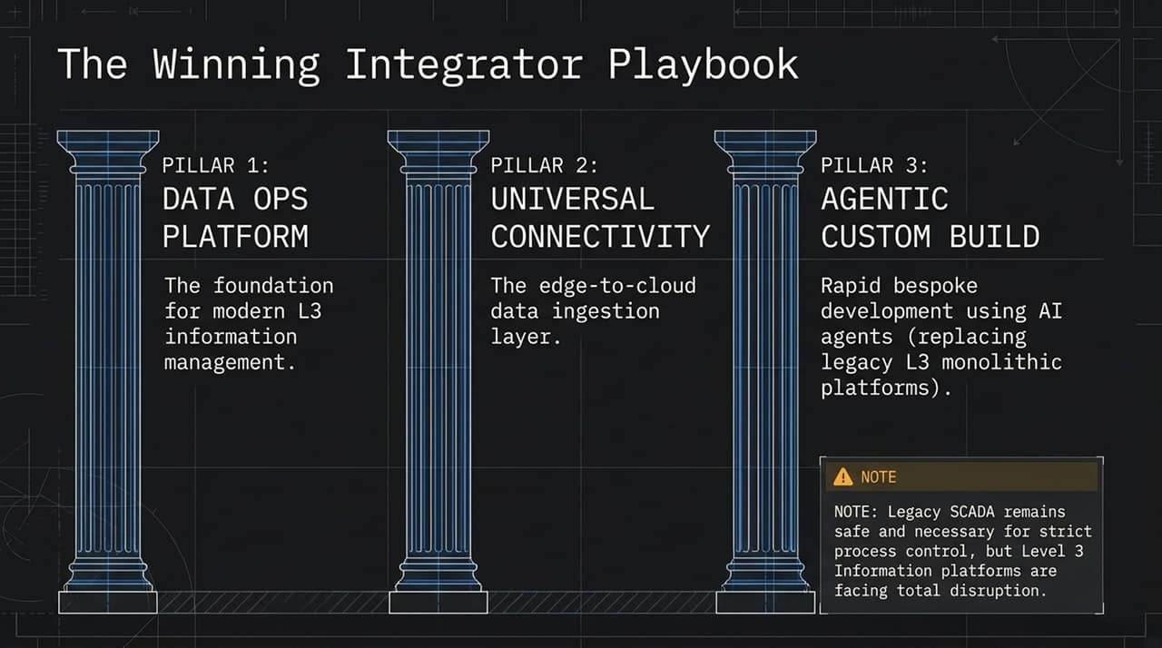
Notes:
Software architecture is undergoing a fundamental transformation.
The Old Way: A human operator logs into a proprietary GUI designer (like an Ignition Designer or SCADA studio) to build screens and logic, which then talks to backend APIs.
The AI-Native Way: The Agent Node bypasses the GUI entirely and connects directly to Backend APIs and hardware hooks.
Why GUIs are changing: A user interface is just a human access point to a function. AI agents don't need graphical user interfaces; they need API hooks and file-system access.
The OS Metaphor: Look at AI-native operating systems (like Omari Linux vs. standard Ubuntu). In standard OS environments, you have to manually copy system logs into an AI application. In an AI-native environment, the AI sees all system logs natively at the hardware/kernel level.
Warning to Software Vendors: If your software requires an AI agent to guide a human through clicks in your proprietary GUI, your product is falling behind. Interfaces should remain primarily for human validation.

Slide 10
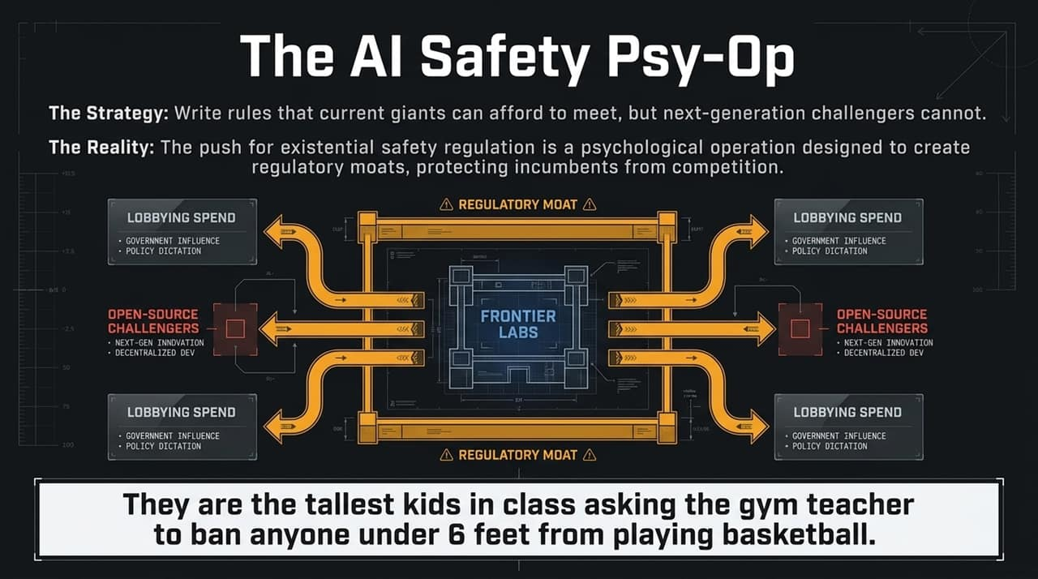
Notes:
For systems integrators and engineering teams, the playbooks of the last decade are no longer effective. The winning architectural strategy is resting on Three Pillars:
Pillar 1: Data Ops Platform
The core foundation for modern Level 3 information management (e.g., platforms like MaestroHub).
Pillar 2: Universal Connectivity
An edge-to-cloud data ingestion layer capable of normalizing data from any industrial asset (e.g., Litmus).
Pillar 3: Agentic Custom Builds
Replacing monolithic L3 applications by using AI agents to rapidly build bespoke, lightweight applications directly on top of the Data Ops and UNS foundation.
Crucial Distinction: Legacy SCADA systems remain necessary for strict process control. However, Level 3 Information Platforms, MES, and traditional IoT monoliths are experiencing complete disruption. Integrators who adopt this 3-pillar strategy can deliver higher value at a fraction of traditional development costs.

Slide 11
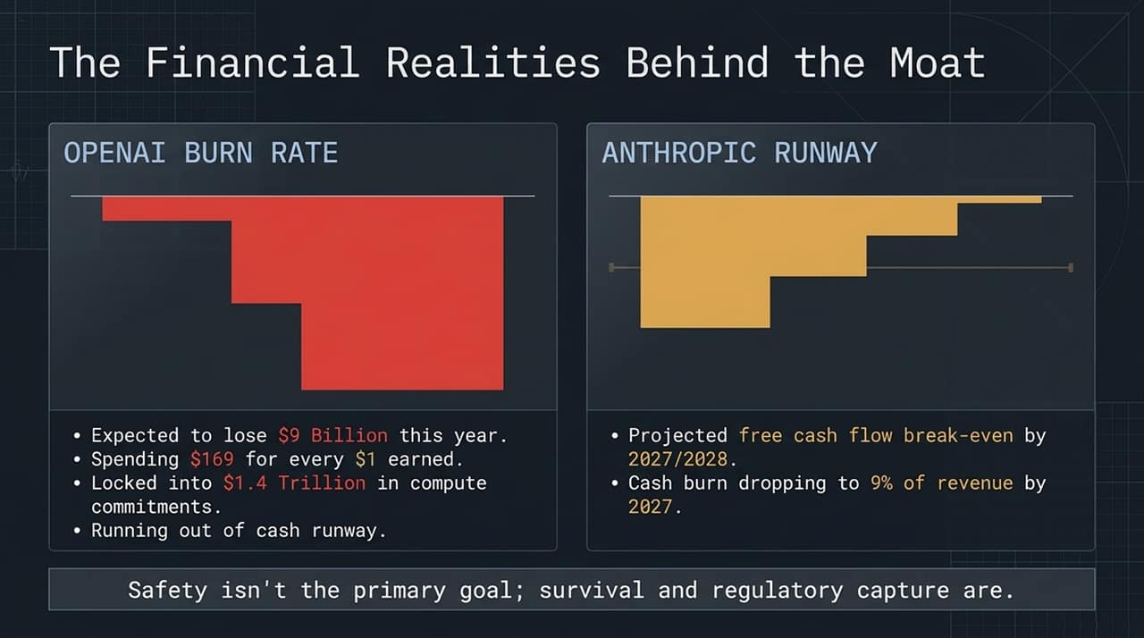
Notes:
Now, let's address the intense public debate around AI safety and regulation.
When major frontier labs (like OpenAI and Anthropic) publicly warn about catastrophic existential threats and demand strict government oversight, you need to look at their actions, not just their words.
Much of the push for 'existential risk' regulation functions as a regulatory moat. Frontier labs spend record amounts on lobbying to shape regulations that only incumbent giants with massive compliance budgets can satisfy. Meanwhile, open-source challengers and smaller innovators get locked out.
As the visual on the slide illustrates: They are the tallest kids in gym class asking the teacher to ban anyone under six feet tall from playing basketball because it’s 'dangerous.'
We do need regulation, but we must distinguish between genuine operational safety and corporate regulatory capture.

Slide 12
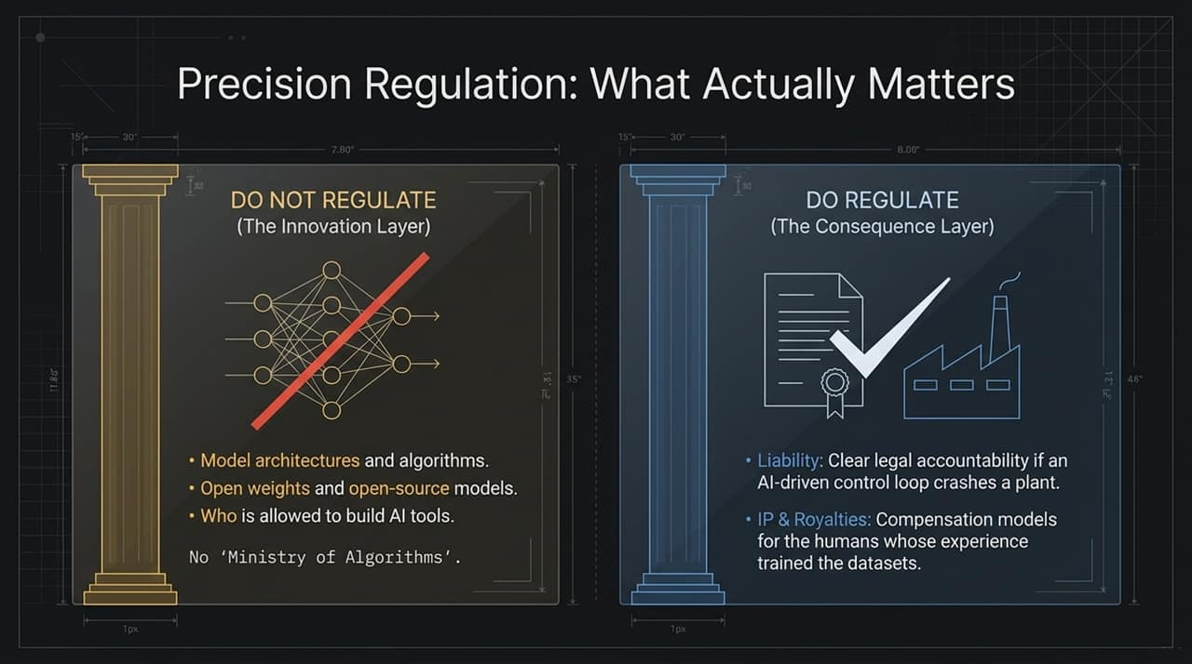
Notes:
To understand why frontier labs are lobbying so aggressively, follow the money. The urgency behind regulatory capture is driven by underlying financial realities:
OpenAI Financial Burn:
Projecting a $9 Billion loss this year, spending roughly $169 for every $1 earned.
Locked into an estimated $1.4 Trillion in compute commitments over the coming years.
Operating losses continue to consume a massive percentage of revenue, creating an urgent need to secure market dominance before capital runways shorten.
Anthropic Runway:
Projected cash burn dropping to ~9% of revenue by 2027, with free cash flow break-even targeted for 2027/2028.
While in a relatively better position than OpenAI, they still face significant capital expenditure demands.
When multi-billion-dollar labs burn cash at this rate, establishing a regulatory moat around frontier models becomes a core business strategy for survival.

Slide 13
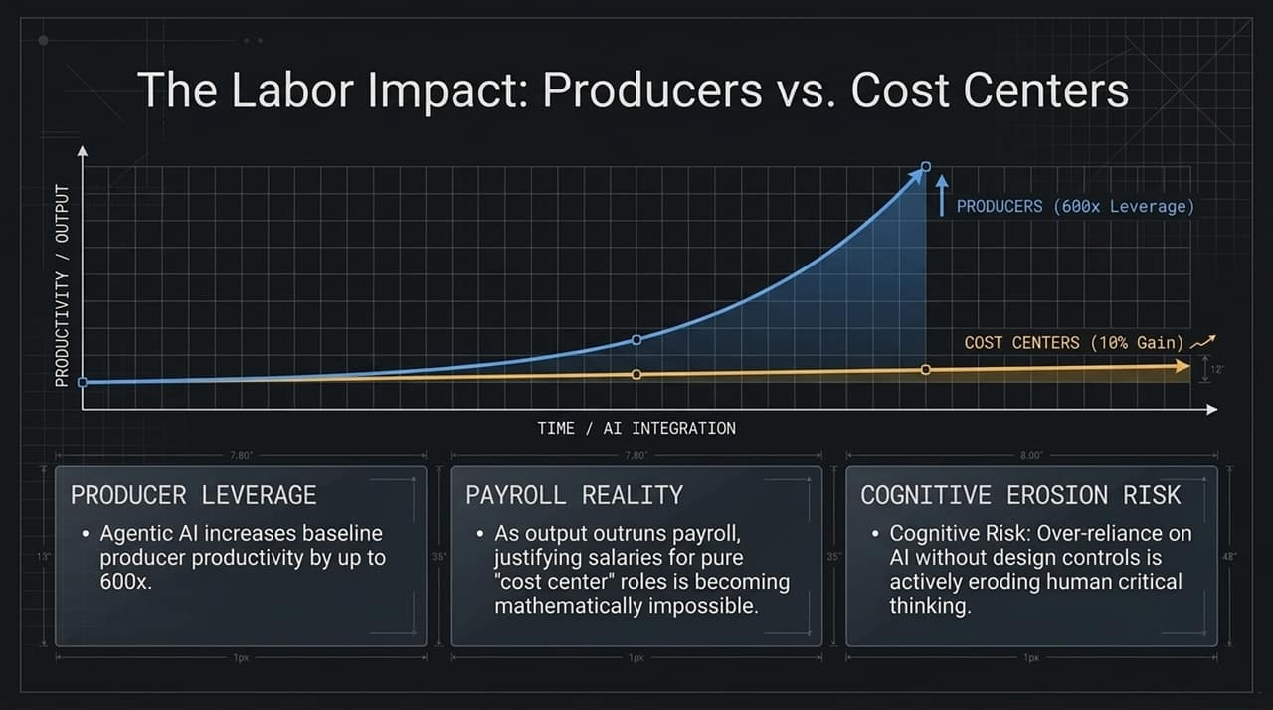
Notes:
We do not need a centralized 'Ministry of Algorithms' dictating who is allowed to write code or train models. Instead, we need Precision Regulation that separates the Innovation Layer from the Consequence Layer.
DO NOT REGULATE (The Innovation Layer):
Model architectures, math, and algorithms.
Open weights and open-source software development.
Licensing access to who is allowed to build AI tools.
DO REGULATE (The Consequence Layer):
Liability: Establishing clear legal accountability when an AI-driven system causes physical damage, financial loss, or facility downtime. Existing regulatory bodies (like OSHA, FAA, or EPA) can enforce rules within their domains without creating new algorithm bureaucracies.
IP & Royalties: Structuring fair compensation models for the human creators whose collective work trained these foundation models.
Regulating downstream consequences protects industry without stifling technical innovation.

Slide 14
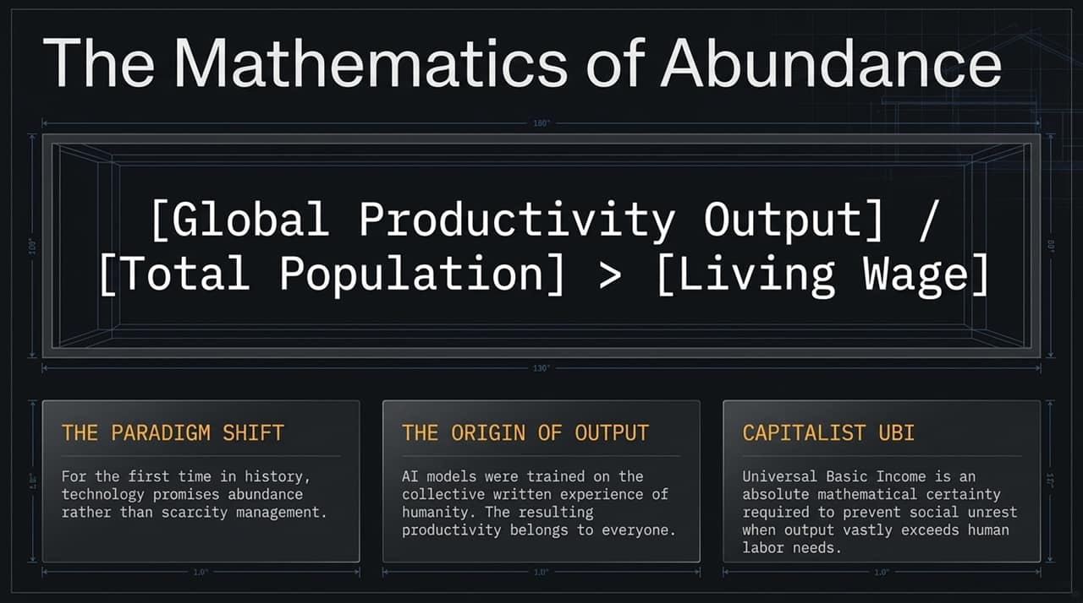
Notes:
Let's examine the shift occurring in the workforce. Agentic AI creates a divergence between Producers and administrative Cost Centers.
1. Producer Leverage:
Highly skilled producers utilizing AI agents can see baseline productivity gains ranging from 10x up to 600x. Tasks that used to take weeks now take hours.
2. The Payroll Reality:
As individual output outruns traditional payroll metrics, justifying fixed salaries for pure administrative 'cost-center' roles becomes mathematically challenging. When a producer's capacity scales exponentially, non-producing overhead layers become visible inefficiencies.
3. Cognitive Erosion Risk:
There is a critical human element to monitor: Cognitive Risk. Over-reliance on AI without design controls and human-in-the-loop validation can erode critical thinking skills. If domain experts rely entirely on agents without maintaining underlying subject mastery, they lose the ability to evaluate model outputs effectively.

Slide 15
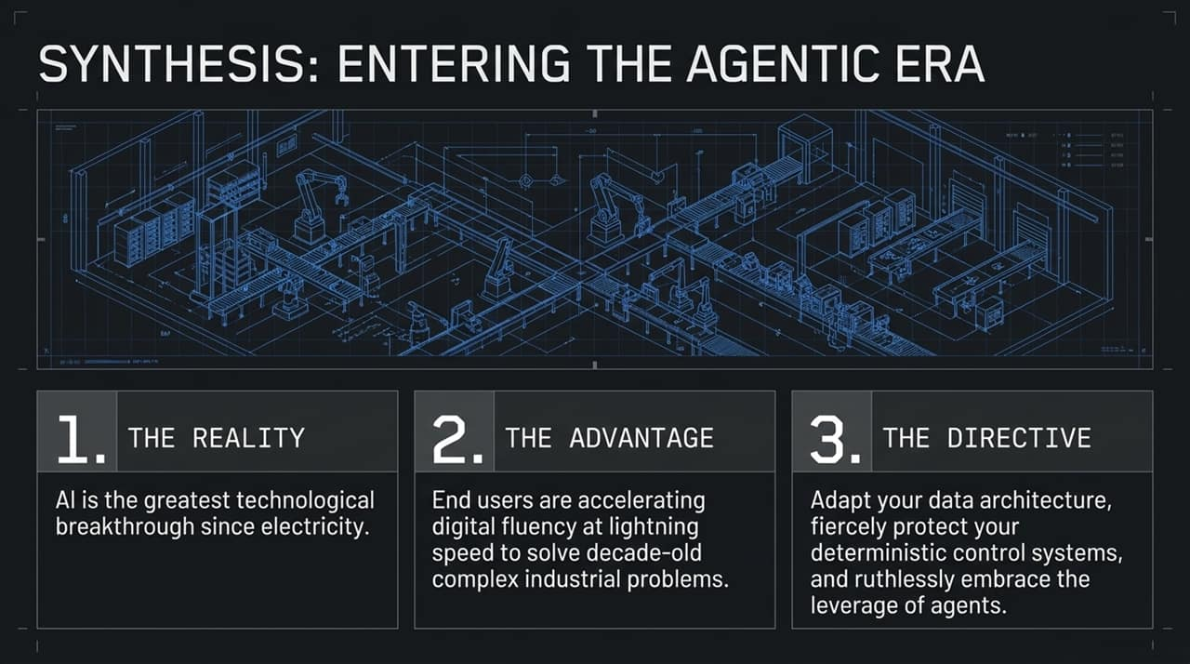
Notes:
Looking broader, AI represents a fundamental economic shift.
The Paradigm Shift: Throughout human history, economic models have managed scarcity. AI introduces the possibility of managing abundance. For the first time, global productivity output divided by total population can realistically exceed the cost of a comfortable living wage.
The Origin of Output:
AI models were trained on the collective written knowledge, software, and operational experience of humanity. Because this productivity leverage stems from shared human input, its benefits should extend broadly across society.
Capitalist UBI:
As productivity gains outpace traditional labor markets, structural policy adjustments like Universal Basic Income (UBI) become a practical economic requirement to maintain consumer demand and market stability. Managing this transition thoughtfully is essential for long-term economic alignment.

Slide 16
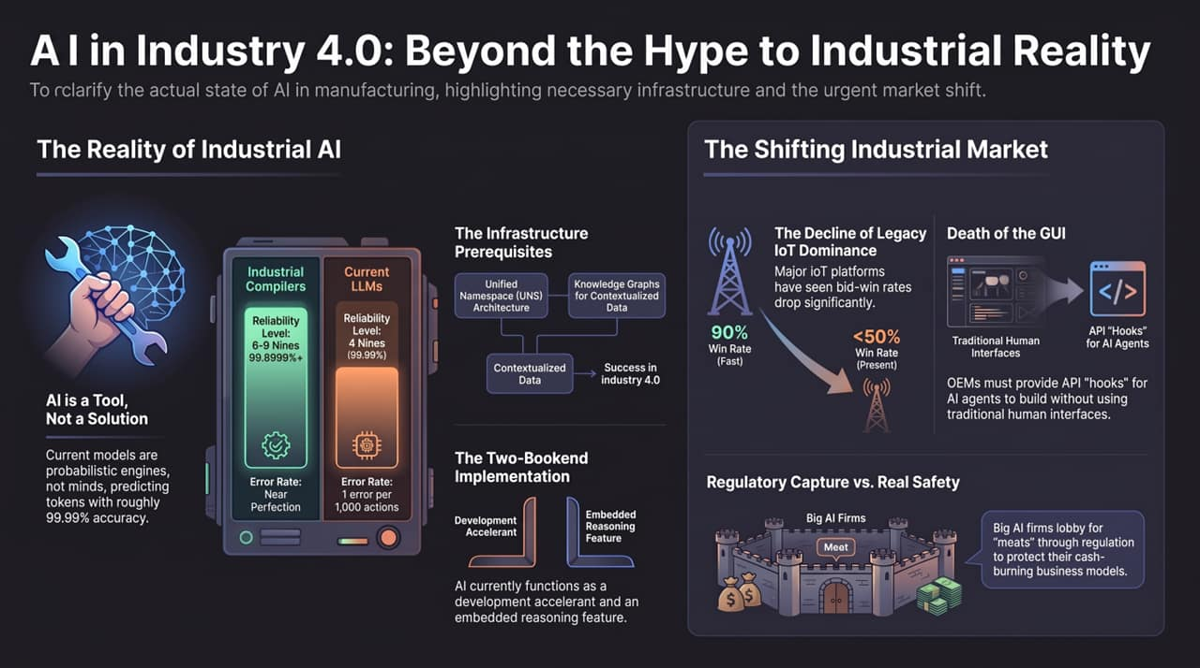
Notes:
To synthesize where we stand as we enter the Agentic Era:
1. The Reality: AI represents a significant general-purpose technological advancement. However, LLMs remain probabilistic tools—not deterministic minds.
2. The Advantage: Industrial end-users are advancing their digital fluency at an unprecedented pace, applying agentic workflows to solve long-standing operational challenges.
3. The Executive Directive:
Modernize Data Architecture: Build a robust Unified Namespace (UNS) and integrate Knowledge Graphs to ensure high-quality context.
Protect Deterministic Control: Keep probabilistic AI out of unsupervised closed-loop operations; maintain deterministic control systems.
Embrace Agentic Leverage: Shift from slow, monolithic software models to lean, API-driven agentic development.
Thank you for your time, and I look forward to taking your questions.
https://www.youtube.com/watch?v=Own2-RUFkRg

